Slide 1
Processing
\\XXXXXX//
XXXXXXXX OOOOOOOOOOOOOOOOOOOO
//XXXXXX\\ OOOOOOOOOOOOOOOOOOOO
////XXXX\\\\ OOOOOOOOOOOOOOOOOOOO
//////XX\\\\\\ |||||||||||||||OOOOOOOOOOOOOOOVVVVVVVVVVVVV
////////\\\\\\\\ |!!!|||||||||||OOOOOOOOOOOOOOOOVVVVVVVVVVV'
//////// \\\\\\\\ .d88888b|||||||||OOOOOOOOOOOOOOOOOVVVVVVVVV'
//////// \\\\\\\d888888888b|||||||||||| 'VVVVVVV'
/////// \\\\\\88888888888|||||||||||| 'VVVVV'
////// \\\\\Y888888888Y|||||||||||| 'VVV'
///// \\\\\\Y88888Y|||||||||||||| . 'V'
//// \\\\\\|iii|||||||||||||||!:::. '
/// \\\\\\||||||||||||||||!:::::::.
// \\\\\\\\ .:::::::::::.
/ \\\\\\\\ .:::::::::::::::.
\\\\\\\\ .:::::::::::::::::::.
\\\\\\\\
\\\\\\\\
Hyland Python Academy @ UCS

Slide 2
Processing is a software sketchbook
Students, artists, designers, and researchers use processing to create dynamic graphics in Java, JavaScript, and Python.

Slide 3

Processing has many features…

Slide 4

Processing has many features…
Shapes

Slide 5
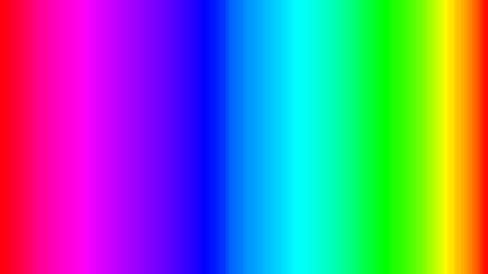
Processing has many features…
Colors

Slide 6

Processing has many features…
Mouse Input

Slide 7
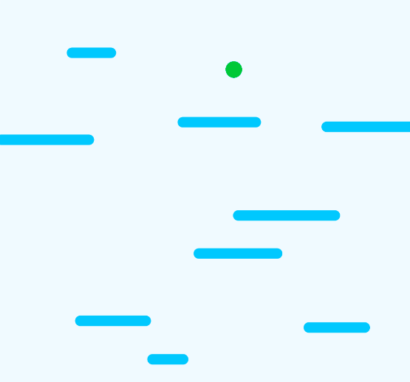
Processing has many features…
Keyboard Input

Slide 8
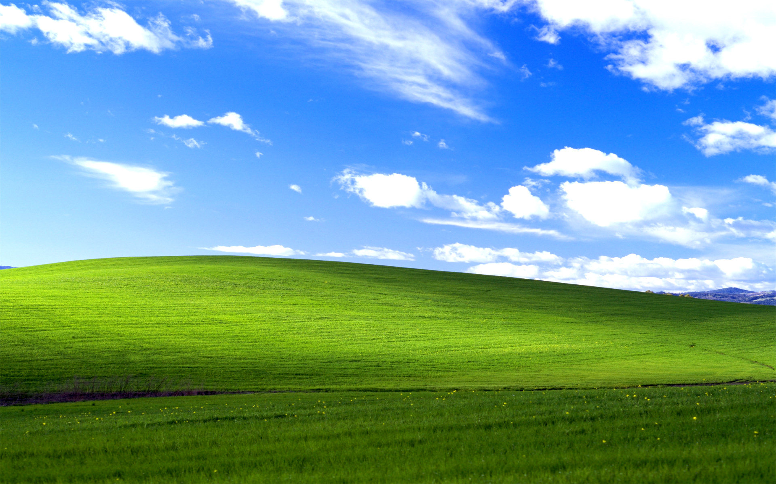
Processing has many features…
Image Loading

Slide 9
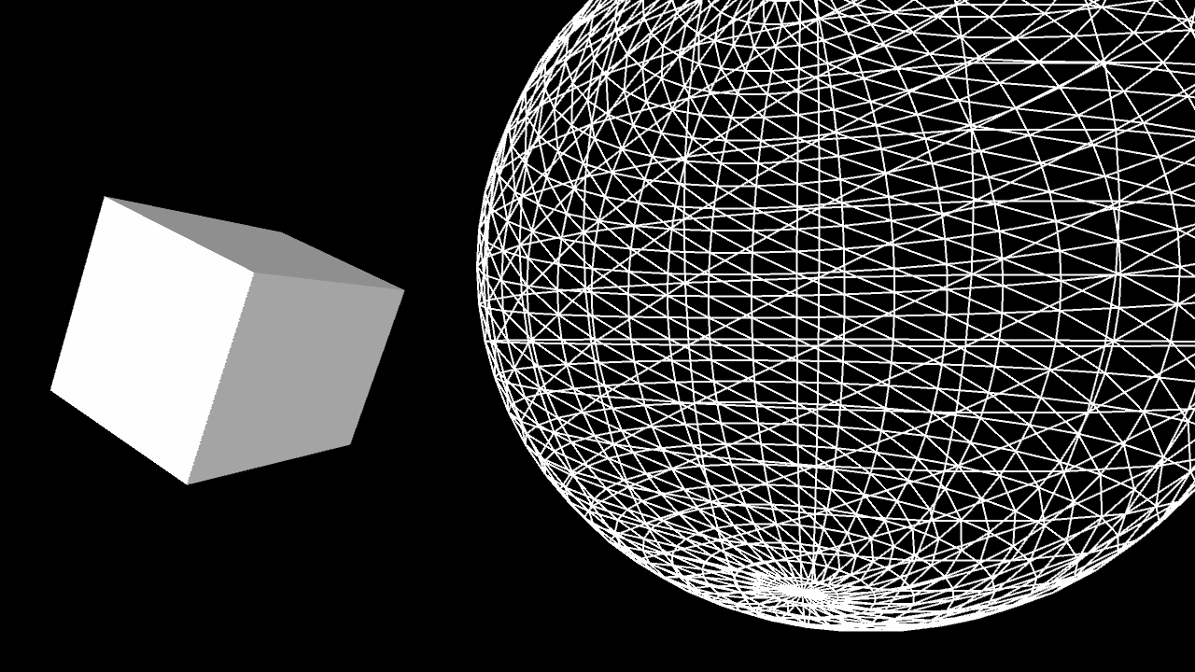
Processing has many features…
3D Graphics

Slide 10
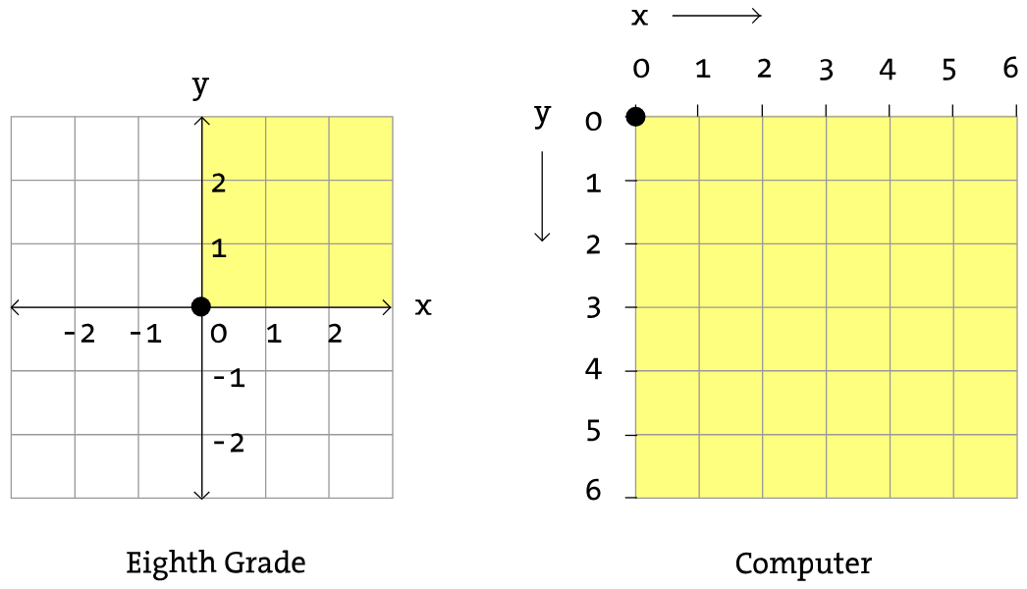
The Processing Canvas

Slide 11
The Processing Canvas
x: 2
y: 1
(2, 1)
(3, 2)
(1, 5)
(5, 4)

Slide 12
Live Example

Slide 13
Into the Code: Library Support
To use Processing, import everything from the processing library, and call the run function.
from processing import *
run()

Slide 14
Drawing Shapes: Ellipse
Create an ellipse (aka oval or circle) by calling the ellipse function.
1
2
3
4
ellipse(120, 100, 40, 40)
1
Center X
2
Center Y
3
Width
4
Height

Slide 15
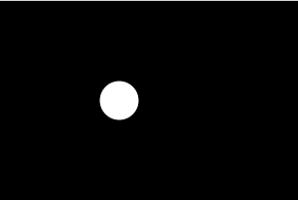
Drawing Shapes: Ellipse
ellipse(120, 100, 40, 40)
1
2
3
4
Center X Coordinate
Center Y Coordinate
Width
Height
100
120
40
40

Slide 16
Drawing Shapes: Rectangle
Create a rectangle by calling the rect function.
1
2
3
4
rect(90, 50, 30, 20)
1
Corner X
2
Corner Y
3
Width
4
Height

Slide 17
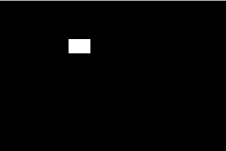
Drawing Shapes: Rectangle
1
2
rect(90, 50, 30, 20)
4
3
50
Corner X Coordinate
Corner Y Coordinate
Width
Height
90
20
30

Slide 18
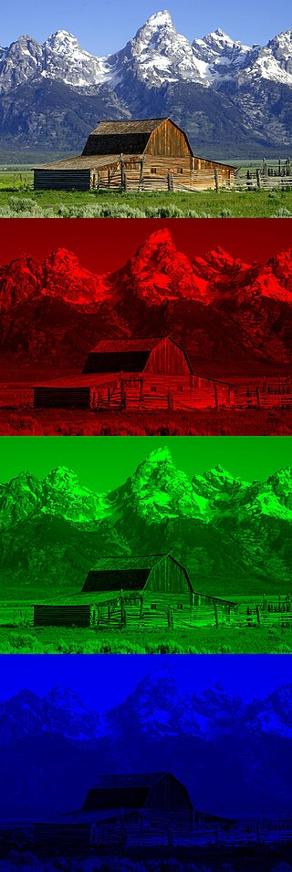
RGB Colors
Functions like background and fill need colors.
background(0, 0, 255)
1
2
3
Red
Green
Blue
0-255
fill(255, 0, 0)
1
2
3

Slide 19
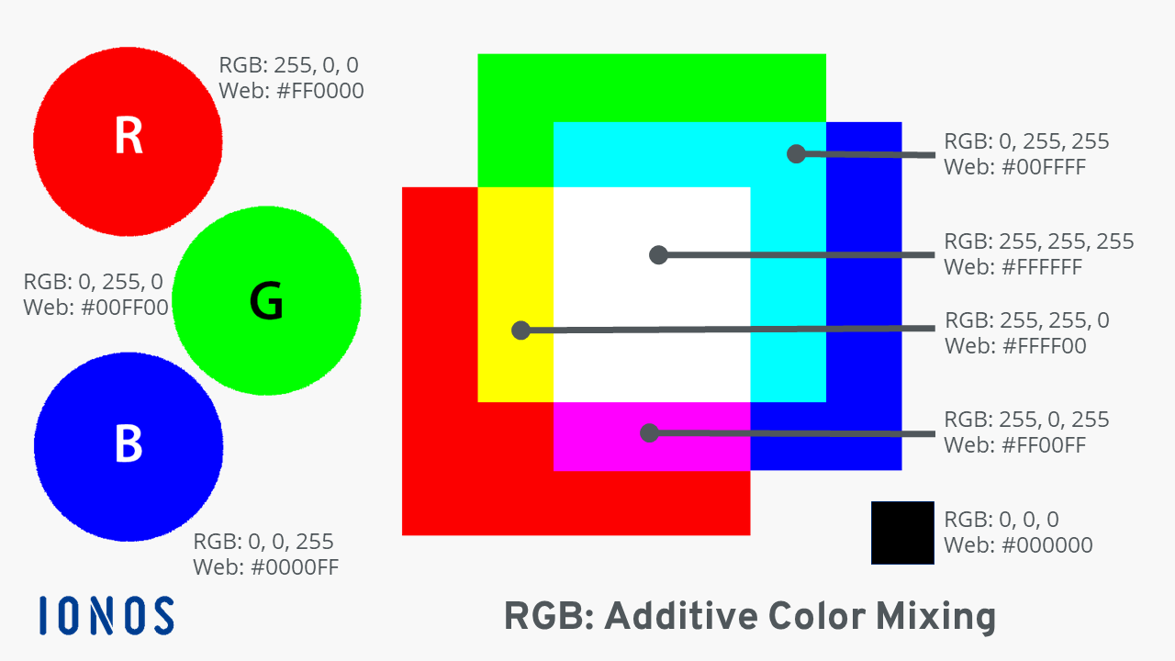
RGB Colors

Slide 20
Canvas Setup
Setup the canvas by defining the setup function. Within the function, call the size and background functions.
def setup():
size(300, 200)
background(255, 255, 0)
Width: 300
255 Red +
255 Green +
0 Blue =
YELLOW
The setup function must be defined!
Height: 200

Slide 21
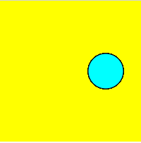
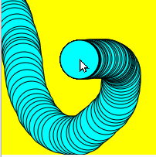
New Canvas Frame
Update the canvas every frame by defining the draw function. This function will be called each frame.
def draw():
fill(0, 255, 255)
ellipse(150, 100, 50, 50)
def draw():
fill(0, 255, 255)
ellipse(mouseX, mouseY, 50, 50)

Slide 22
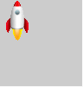
Loading & Showing Images
Load pictures by calling the loadImage function within the setup function. Then, draw them by calling the image function within the draw function.
def setup():
global img
img = loadImage("rocket.png")
def draw():
image(img, 0, 0)

Slide 23
Live Example

Slide 24
Questions?

